Slide 1
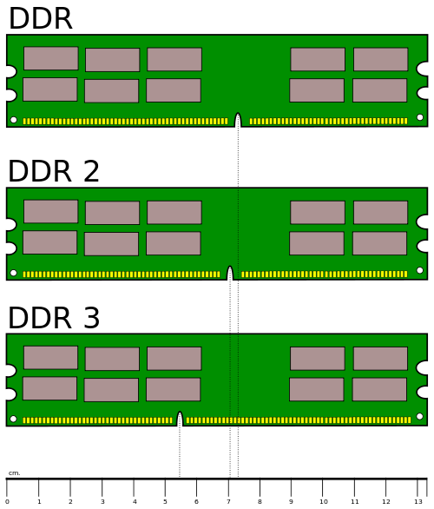
Different positioning of notches makes RAM installation idiot proof.

Slide 2
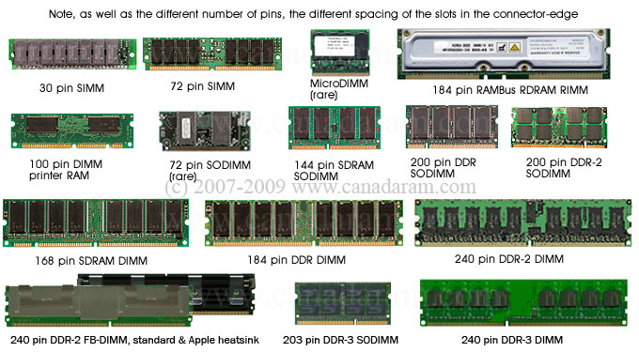
Different types of RAM sticks. Notice the notches. Also, SIMM has contacts on only one side. Heat spreaders illustrated on top right RAM stick. SODIMM is for laptops.

Slide 3
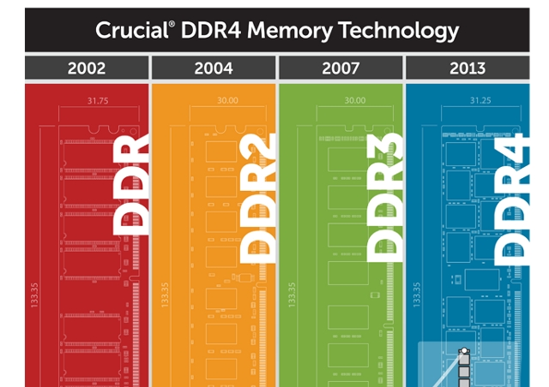
DDR SDRAM release dates. Notice that they are all basically the same size.

Slide 4
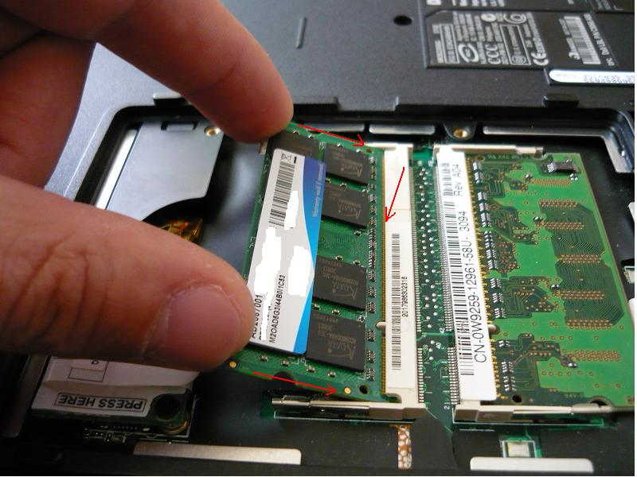
Laptop memory retaining clips and notches with matching keys.

